Slide 1
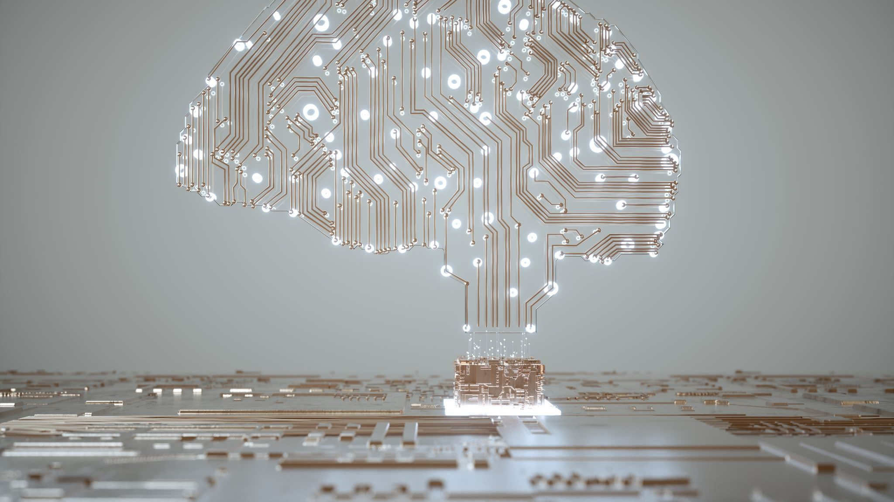
Artificial Intelligence
Year 5 - 6

Slide 2
Generative vs Predictive AI
Generative AI can generate content in the form of text, images, videos and voices.
Predictive AI guesses what might happen next or assigns a label to a piece of information it is given. For example, it might receive an image and be able to guess what is in that image, like a dog or a tree.

Slide 3
Generating Our Own Character
First, you need to pick whether your character will be a hero or a villain and come up with a name for your character
Next, you will write down 5 characteristics for this character (physical characteristics, powers, abilities, weapons)
Copy the name of this character and its characteristics in the image generator on Canva

Slide 4
Predictions
Now share the image of your character with a friend, and they must guess whether the character is a hero or villain, and discuss why they made their choice
Try this with at least 2 other people

Slide 5
Reflection
We made predictions and assumptions about the characters based on our prior knowledge and experiences
Do you think you could train AI to make similar assumptions?

Slide 6

Analyse an AI
Please select an application that uses AI and analyse it using the worksheet provided

